Slide 1
PH203 PROJECT Calculation of Throughput and Pumping Speed in a Vacuum Chamber
N.V. Vineeth
2001CS49
Prabhjot Singh
2001CB39
Pratham Gupta
2001ME49

Slide 2
INTRODUCTION
In this project, we will study about throughput and pumping speed and how to calculate them using different parameters. We will deploy a web application interface and write a program for their calculation using two different methods i.e. using gas equation and the formula for pumping speed for a diaphragm pump.

Slide 3
Theory
THROUGHPUT (Q)
It is the quantity of gas flowing through a pipe per unit time. (Also sometimes, referred to as the product of pumping speed and the inlet pressure). Unit: Pa.m3/s = W
Also, if Q > 200D => Turbulent and if Q > 100D => Laminar
PUMPING SPEED (Sp)
The volume of gas per unit time (dV/dt) which the pumping device removes from the system at the pressure existing at the inlet of the pump.
Unit: litres/s, m3/hr

Slide 4
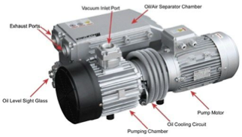
CALCULATIONS
Using Gas Equation
Throughput (Q) = P * (d(V)/d(t))
=> Q = (dN/dt) * (R.T)
Pumping Speed (S) = Q / P
where, n = Moles of Gas, P = Pressure,
T = Temperature, t =Time

Slide 5
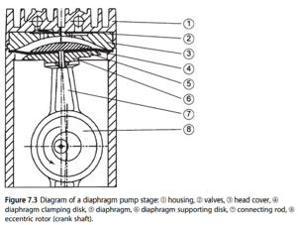
CALCULATIONS
For a Suction Chamber Throughput(Q) = q_{p}V
Q = n * (V_{s} * p_{in} - V_{D.S} * P_{out})
Pumping Speed (S) = Q/p_{in}
where, N = Rotational Speed V_{s} = Suction Chamber Volume
P_{in} = Input Pressure V_{D.S} = Dead Space Volume P_{out} = Output Volume

Slide 6
CODE ANALYSIS
For Gas Equation
var throughput = (inputs[0].value * 8.314 * inputs[2].value) / inputs[3].value; var pumpingSpeed = throughput / inputs[1].value;
where,
input[0] = Moles of gas, input[1] = Pressure,
input[2] = Temperature, input[3] = Time

Slide 7
CODE ANALYSIS
For Suction Chamber
var throughput = inputs[0].value * (inputs[4].value * inputs[1].value - inputs[3].value * inputs[2].value) var pumpingSpeed = throughput / inputs[1].value
where,
input[0] = Rotational Speed, input[1] = Input Pressure,
input[2] = Output Pressure, input[3] = Dead Space Volume,
input[4] = Suction Chamber Volume

Slide 8
Links of the Code and the Deployed Website
Link of the code uploaded on the google drive:
https://drive.google.com/drive/folders/1ynyAipDhC0C9HRJ4Wz847 5ZVgr4qcXkN
Link of the website deployed on netlify:
https://ph203projectcs73-49-32.netlify.app/

Slide 9
SCREENSHOTS Of The Website Made

Slide 10
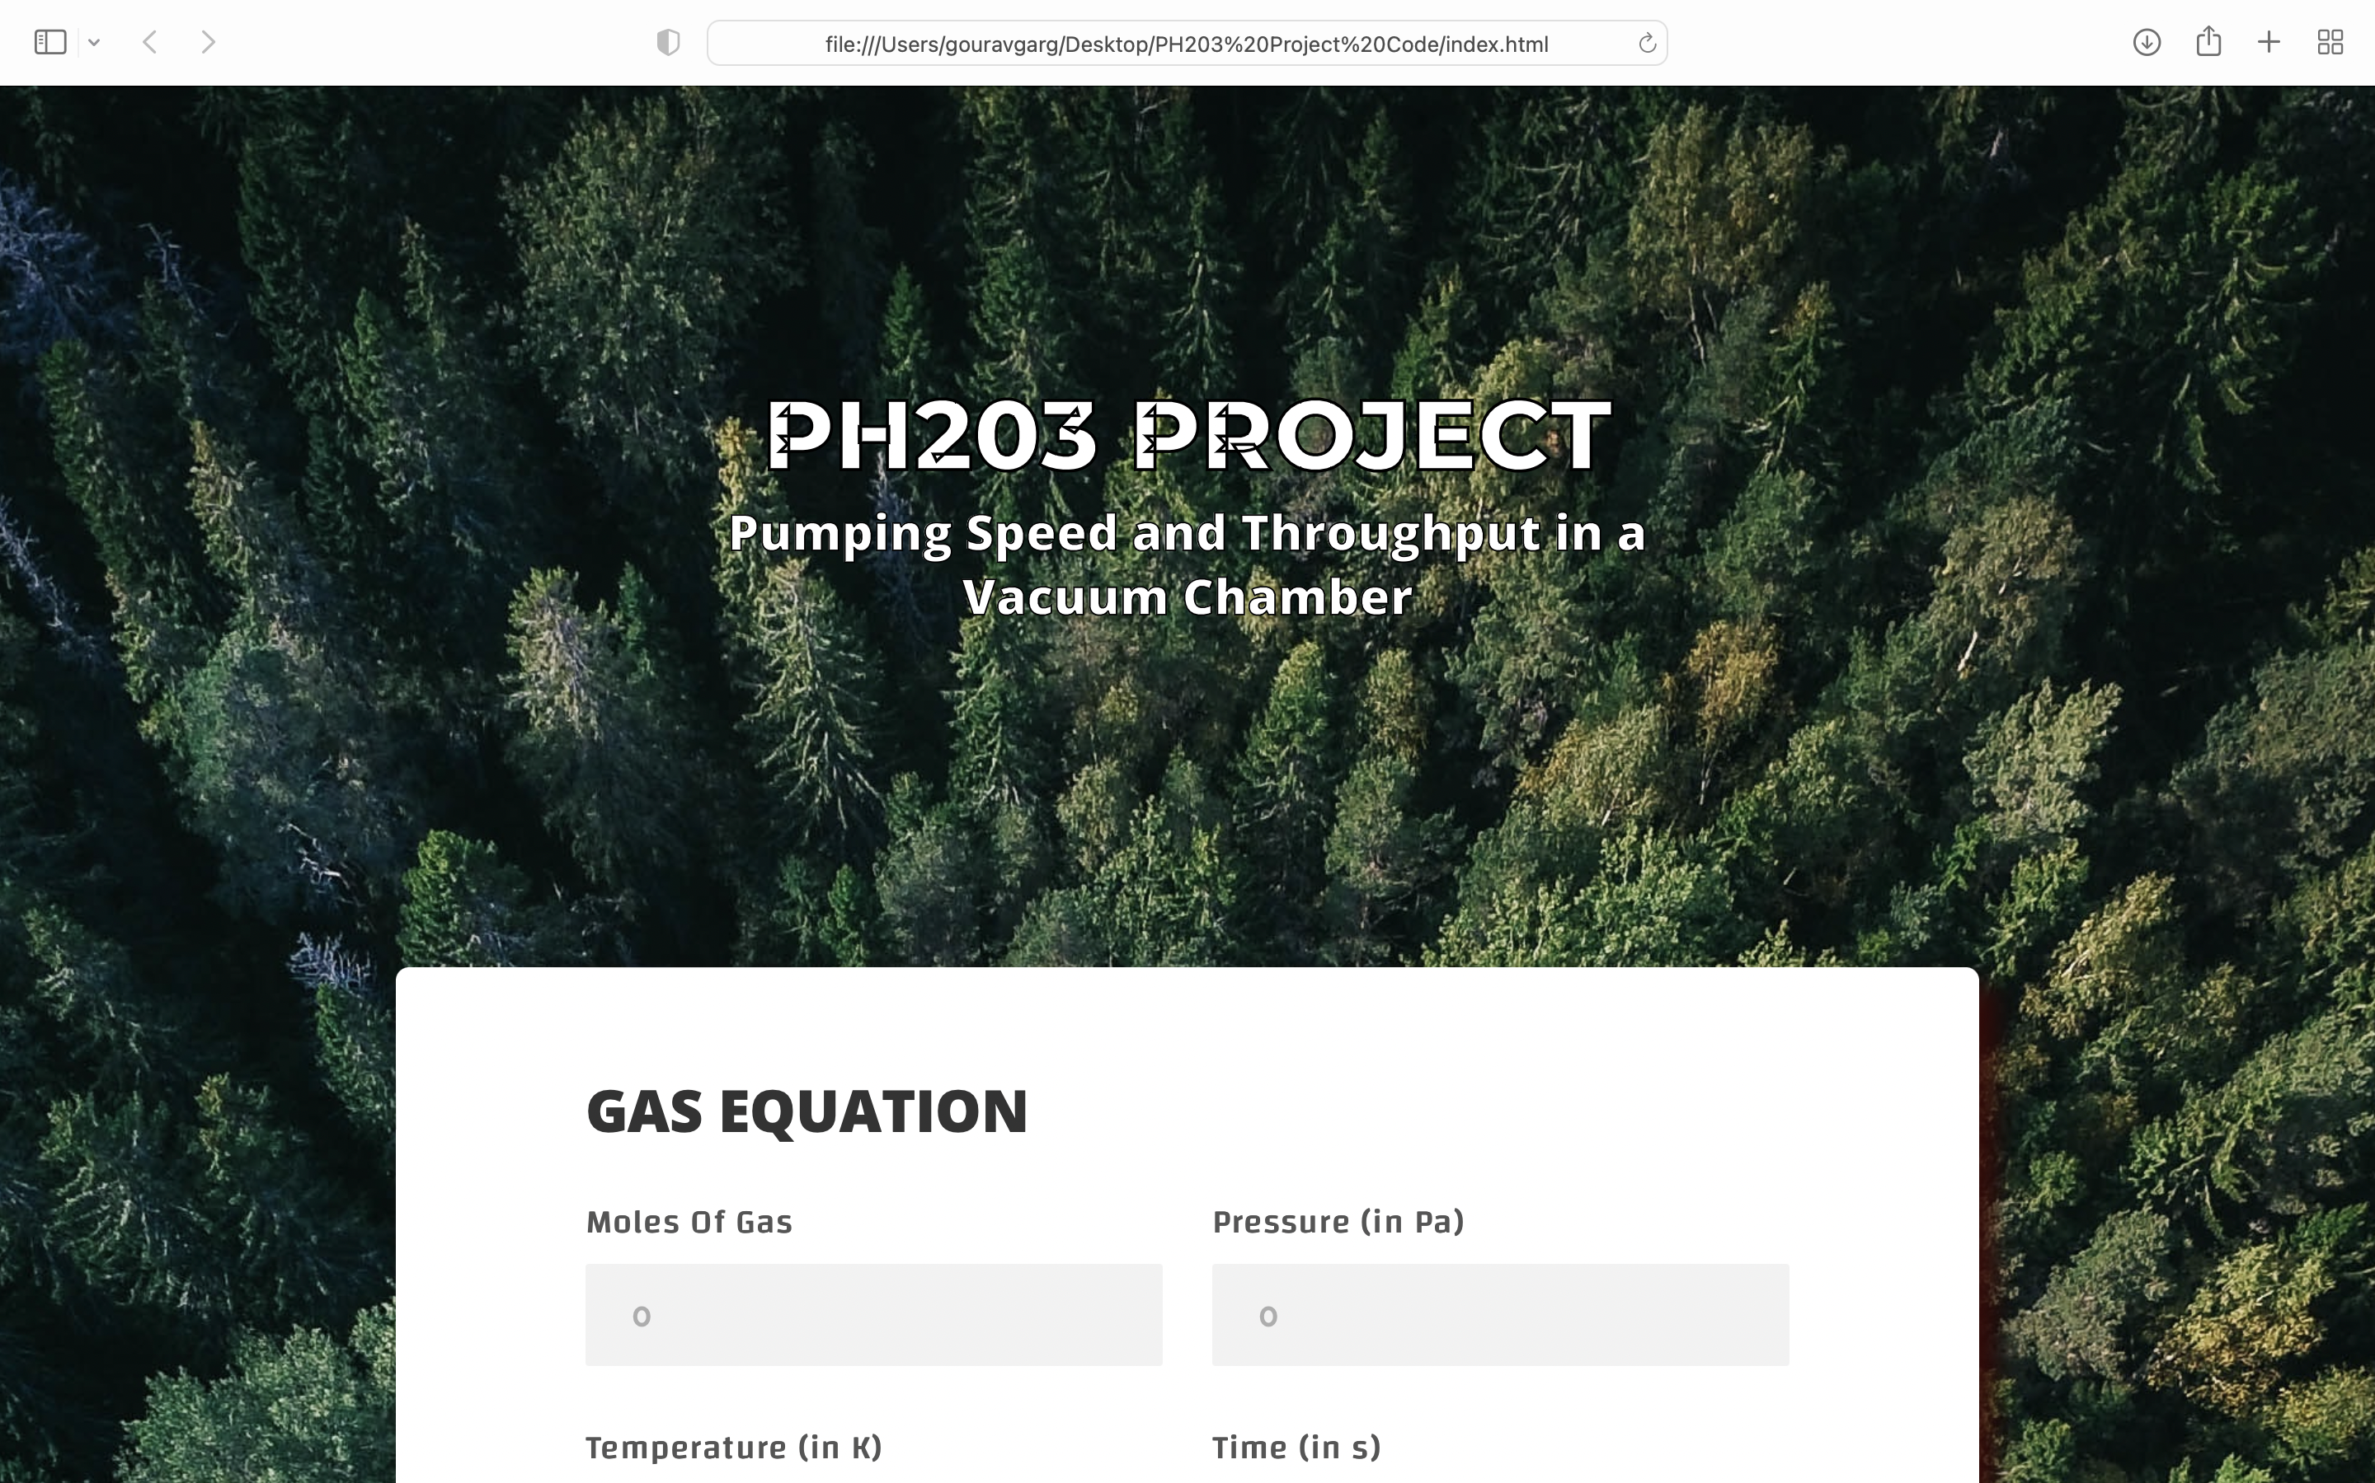

Slide 11
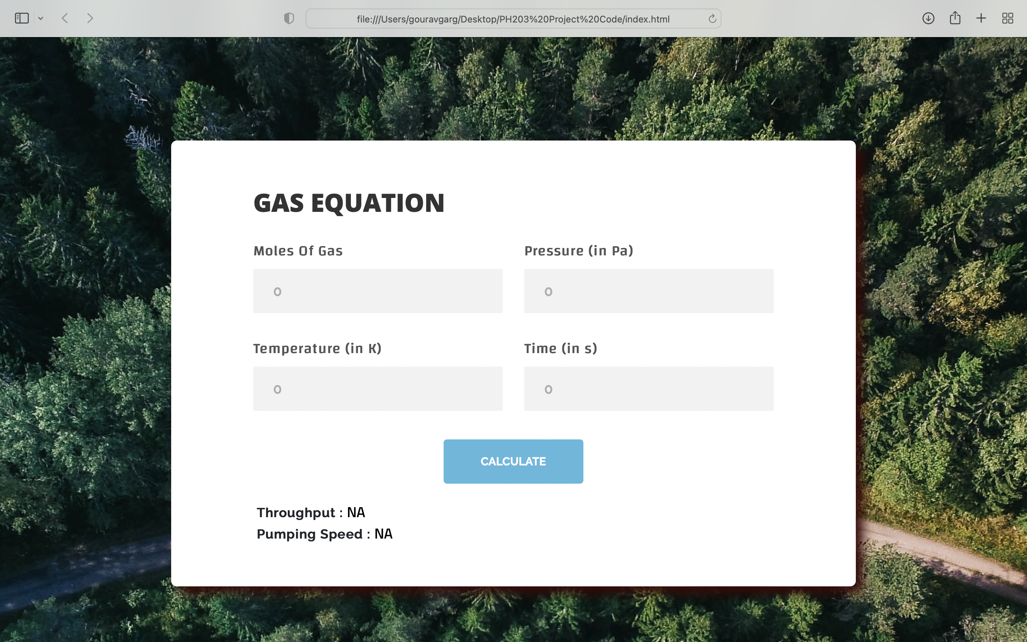

Slide 12
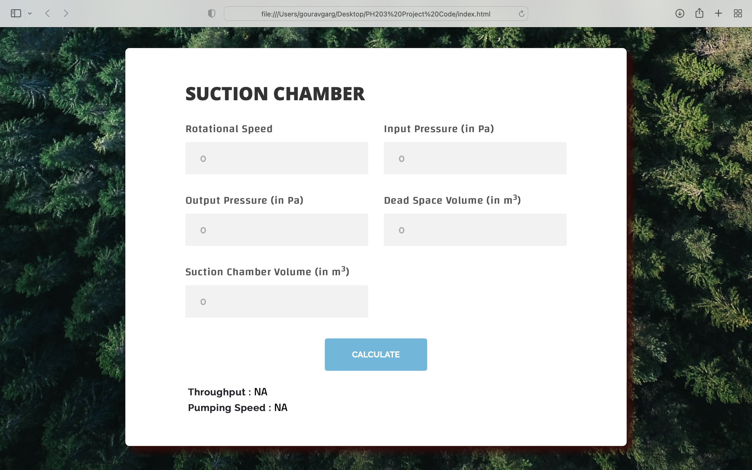

Slide 13
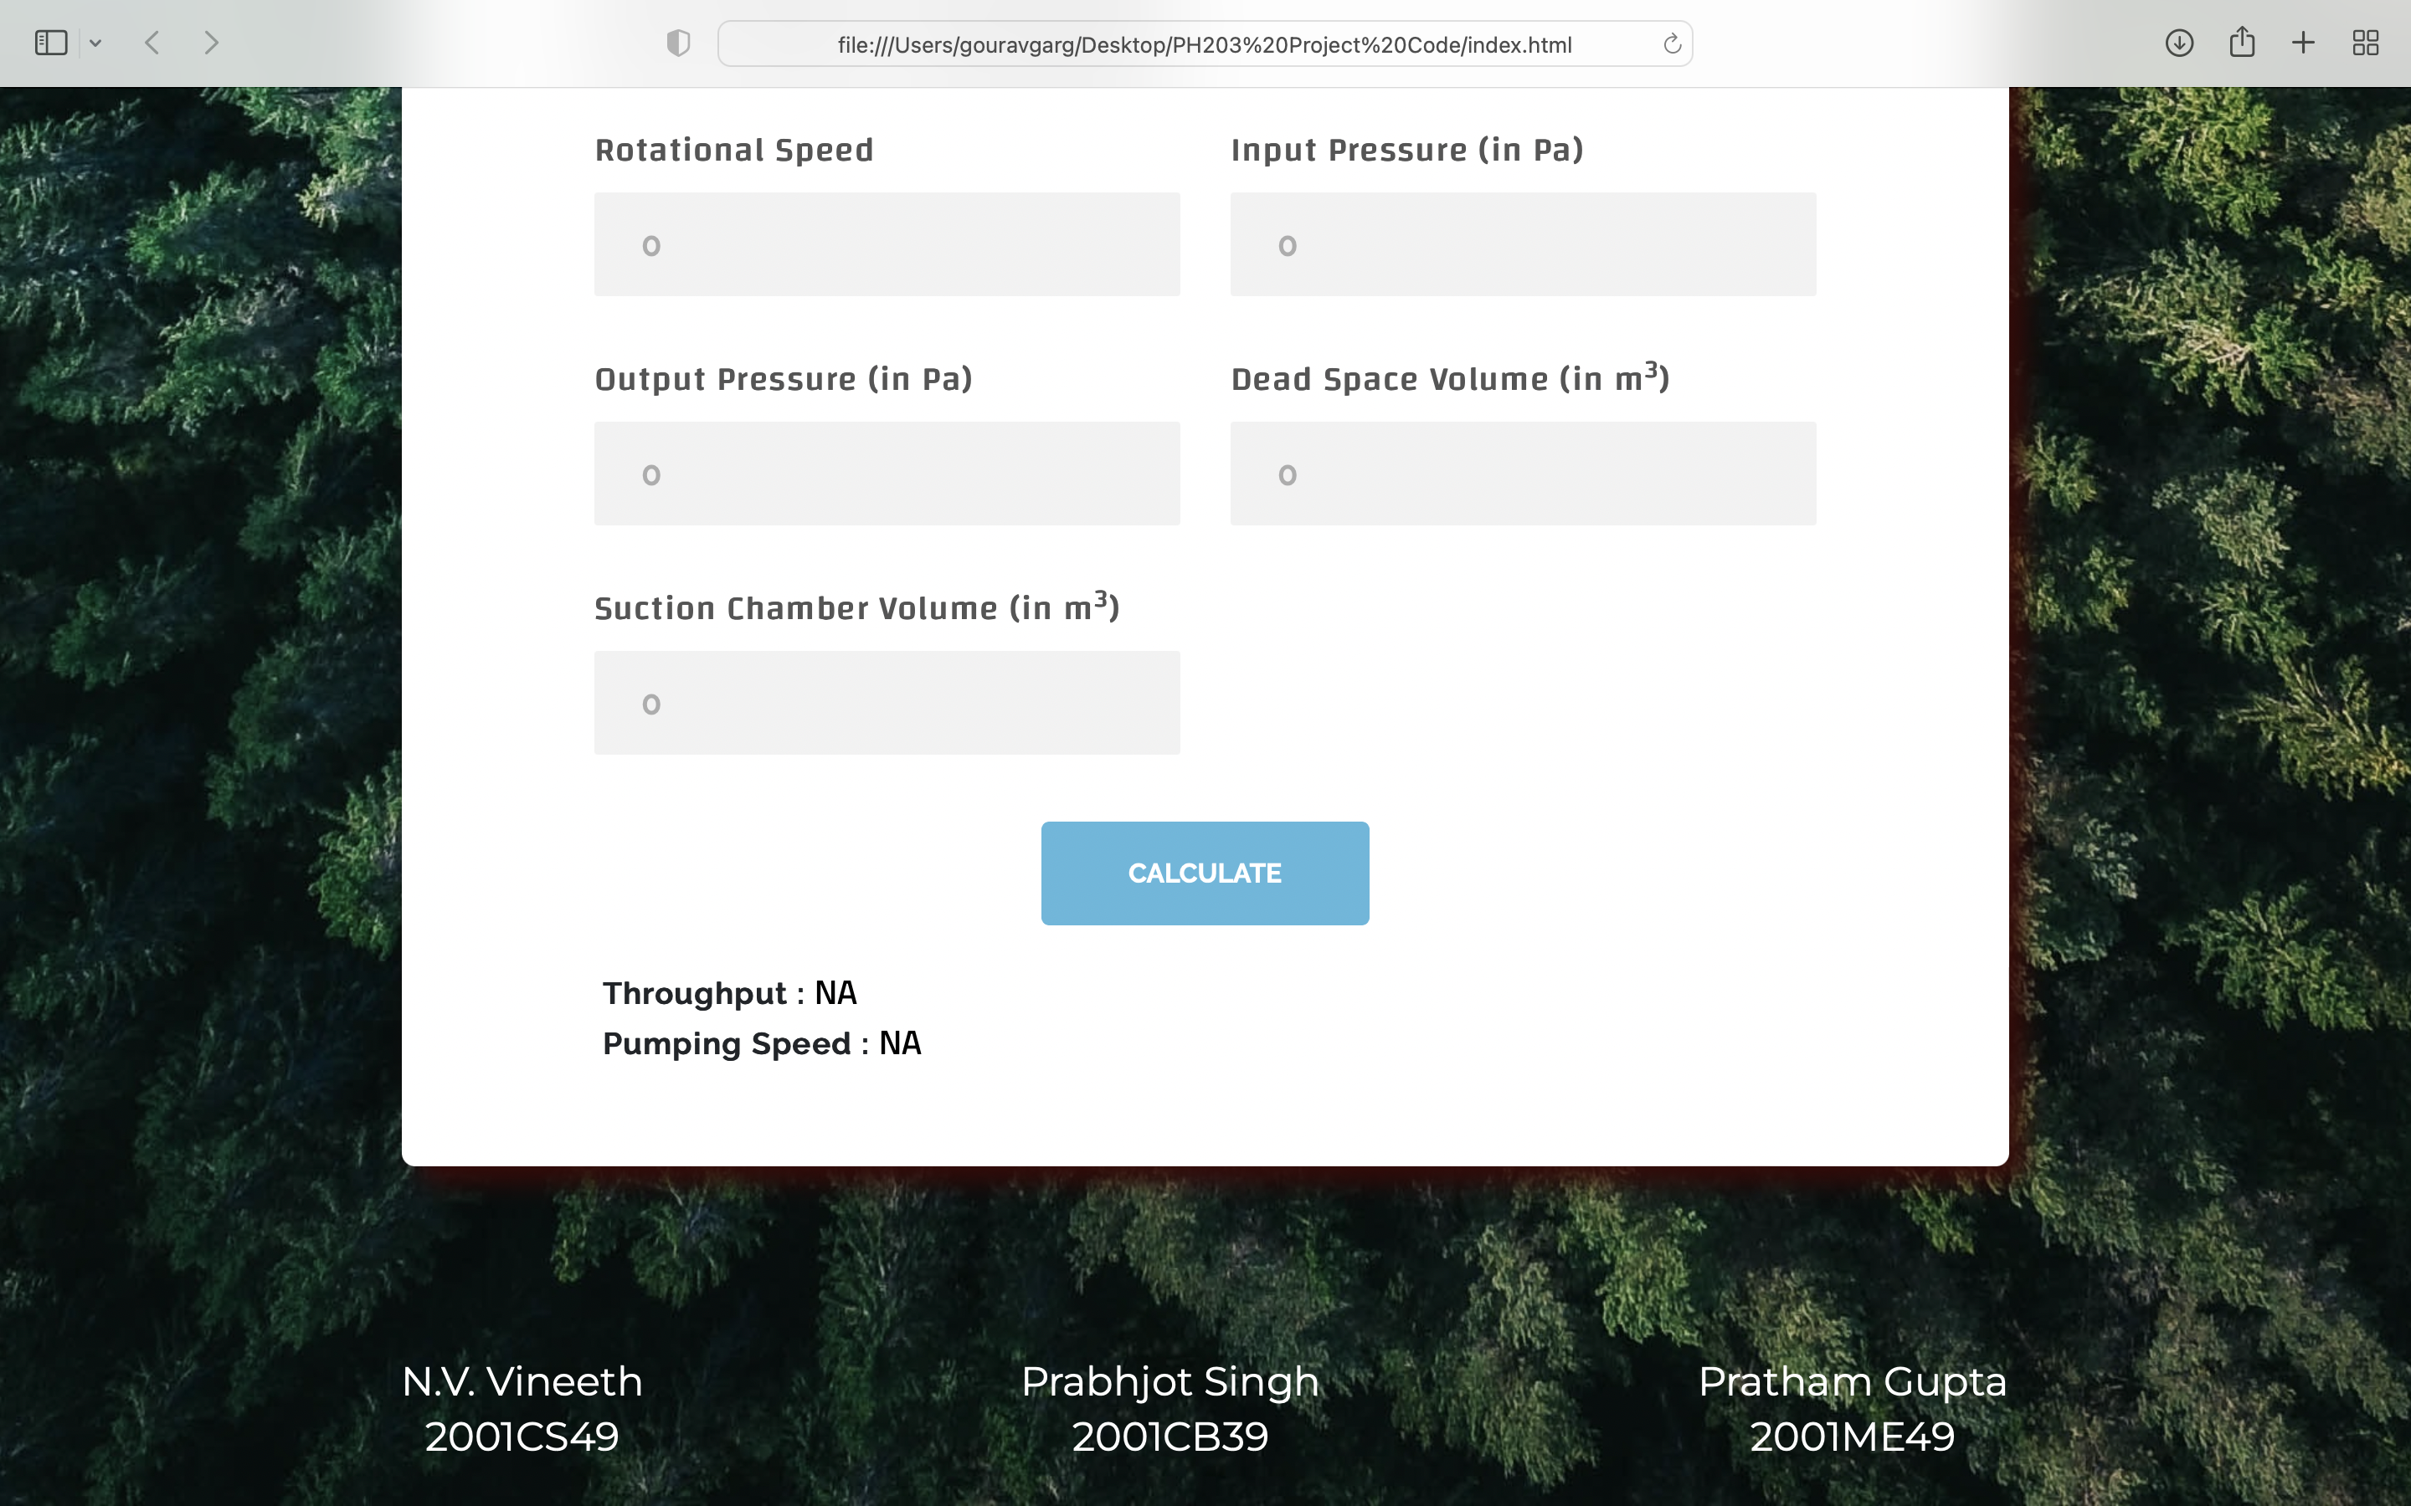

Slide 14
CONCLUSION
In this project, we studied about throughput and pumping speed and how to calculate them using different parameters. We also created a web application interface for calculation of throughput and pumping speed in a vacuum chamber. Many such soft-wares can be created for the ease of engineers that are useful in many cases.
So, at the end, we achieved our goal and wrote a program for the calculation of throughput and pumping speed successfully.

Slide 15
In two or three columns
Yellow
Is the color of gold, butter and ripe lemons. In the spectrum of visible light, yellow is found between green and orange.
Blue
Is the colour of the clear sky and the deep sea. It is located between violet and green on the optical spectrum.
Red
Is the color of blood, and because of this it has historically been associated with sacrifice, danger and courage.

Slide 16
PRABHJOT SINGH (2001CB39)
Understood the assignment and formed the basics of the project.
PRATHAM GUPTA (2001ME49)
Contributed in the development and the overall design of the website made.
CONTRIBUTIONS
N.V. VINEETH (2001CS49)
Contributed in the design framework and making of the report.

Slide 17
THANK you!
N.V. Vineeth
2001CS49
Prabhjot Singh
2001CB39
Pratham Gupta
2001ME49

